Slide 1

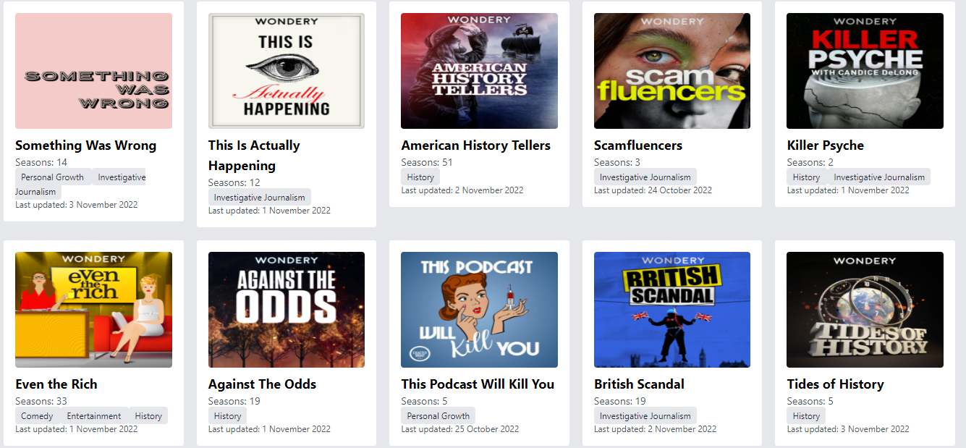

Podcast App
By: Lesego Shange

Slide 2


Overview
Introduction
01
Project Setup Instructions
02
App Walkthrough 1
03
App Walkthrough 2
04
App Structure
05
Data Fetching
06
Key features
07
Our Team
08

Slide 3

Introduction
Brief Overview: The podcast app aims to provide a comprehensive platform for users to browse, filter, and listen to podcasts. Built using React and TypeScript, it offers features such as browsing shows, filtering by genre, listening to episodes, and managing favorites.
Technologies Used: React, TypeScript and Tailwind, API integration for data fetching, localStorage for persistence.

Slide 4

Clone the project repository from [This repo].
01
Project Setup Instructions
Navigate to the project directory: cd Podcast App
02
Install dependencies:
npm install
03
Start the development server:
npm run dev
04

Slide 5
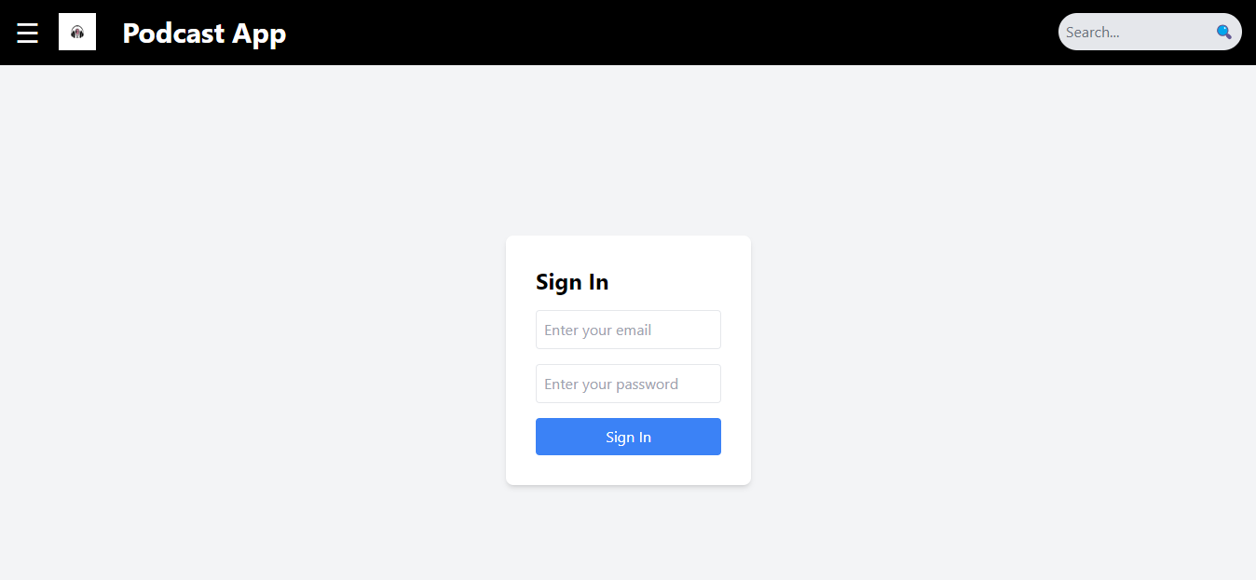
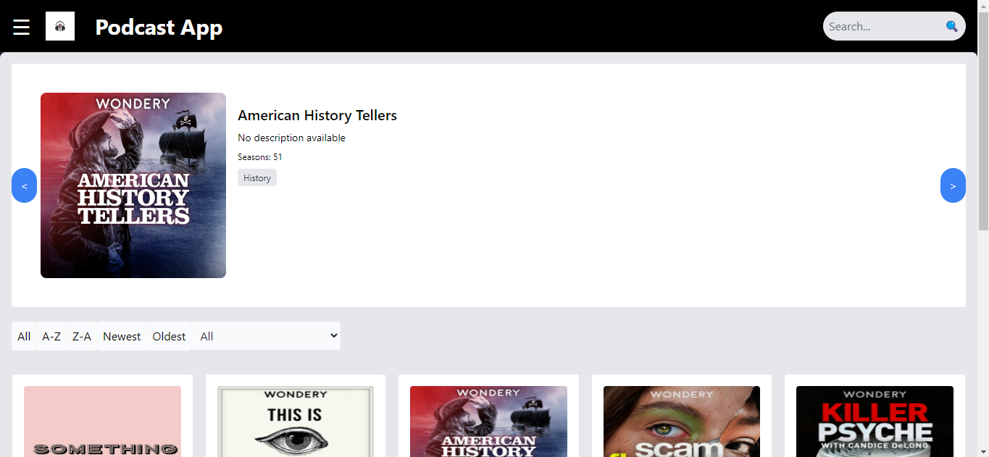
App Walkthrough 1
Sign In page
Dashboard page
User signs in by entering their email address and password, then click submit
Sign In page routes to the Dashboard page of the podcast app, where a carousel displays show options , buttons to filter the list of shows and the list of shows

Slide 6
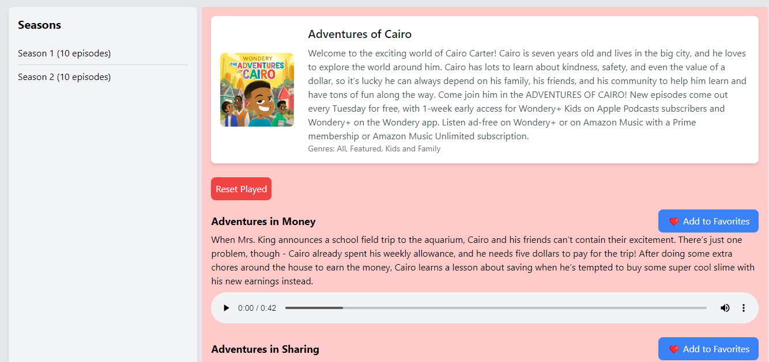
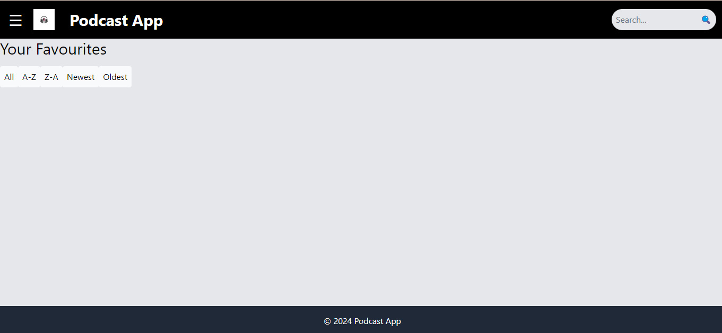
App Walkthrough 2
PodcastShow page
Favourites page
When the user clicks on a show in the show list, the app routes to a page where it displays the show
Accessed through the navigation menu, the Favourites page holds all the episodes that were “favourited” by the user while on the PodcastShow page of an show

Slide 7

App Structure
The Podcast App is made up of the following files:
In the root directory(Podcast App)
Index.html
src folder
In the source directory:
main.tsx
App.tsx
index.css
assets folder holding the Podcast App logo
along with the following folders too:
Pages
Components
Utilities
Data
Sign In page
Dashboard page
PodcastShow page
Favourites page
Header
Footer
Carousel
EpisodeList
PodcastDetails
SearchButtons
SeasonsList
ShowList
api
state
genres

Slide 8
Data Fetching
Endpoint Overview:
URLs Used:
https://podcast-api.netlify.app: Returns previews of shows.
https://podcast-api.netlify.app/genre/<ID>: Fetches details of a specific genre.
https://podcast-api.netlify.app/id/<ID>: Retrieves details of a specific show with embedded seasons and episodes.

Slide 9


KEY FEATURES
Sorting shows by filter.
Episode playback and season-specific views.
Genre filtering and display of associated genres.
Use of localStorage for favorites persistence.

Slide 10




THANK YOU!
Lesego Shange
0768026143
makgeledisal@gmail.com

